Slide 1
Structures in C

Slide 2
Topics
Introduction to structures
Accessing structure member elements
Size of of a structure
Aligned and un-aligned data storage
Structure padding
Calculating structure size manually with and without padding
Assembly code analysis of packed and non packed structure
Typedef and structure
Structures and pointers
Structure and bit fields

Slide 3
Introduction to structures
Arrays : Arrays can be used to represent( đại diện) a group of data items that belongs to the same type, such as int or float.
We cannot use an array if we want to represent a collection( thu thập) of data items of different types using a single name.
C supports a constructed datatype known as structures for packing data of different types.
A Structure consists of a group of logically related data items.
For example:
Suppose you need to store information about someone, their name, citizenship, and age. You can create variables like name, citizenship, and age to store the data separately.

Slide 4
Structure definition
The ‘struct’ keyword is used to create a structure.
The general syntax to create a structure is as shown below:
struct structureName
{
member 1;
member 2;
member 3;
.
.
.
member N;
};

Slide 5
Example – Structure Declaration
The struct keyword defines a structure type followed by an identifier (name of the structure).
Then inside the curly braces, you can declare one or more members (declare variables inside curly braces) of that structure
struct Person
{ char name[50];
int age;
float salary;
};
Here a structure person is defined which has three members: name, age and salary
When a structure is created, no memory is allocated.
The structure definition is only the blueprint for the creating of variables.

Slide 6
How to define a structure variable?
Once you declare a structure person as above. You can define a structure variable as:
Structure name Structure Variable
Example : Person bill;
Here, a structure variable bill is defined which is of type structure Person.
When structure variable is defined, only then the required memory is allocated by the compiler.
Considering either 32-bit or 64-bit system, the memory of float is 4 bytes, memory of int is 4 bytes and memory of char is 1 byte.
Hence, 58 bytes of memory is allocated for structure variable bill.

Slide 7
How to access members of a structure?
The members of structure variable is accessed using a dot (.) or member operator.
Structure Variable. Structure member = Value;
To access age of structure variable bill and assign it 50 to it
bill.age = 50;

Slide 8
C Program to assign data to members of a structure variable and display it
#include <iostream>
using namespace std;
struct Person
{
char name[50];
int age;
float salary;
};
int main()
{
Person p1;
cout << "Enter Full name: ";
cin.get(p1.name, 50);
cout << "Enter age: ";
cin >> p1.age;
cout << "Enter salary: ";
cin >> p1.salary;
cout << "\nDisplaying Information." << endl;
cout << "Name: " << p1.name << endl;
cout <<"Age: " << p1.age << endl;
cout << "Salary: " << p1.salary;
return 0;
}

Slide 9
Output
Enter Full name: Magdalena Dankova
Enter age: 27
Enter salary: 1024.4
Displaying Information.
Name: Magdalena Dankova
Age: 27
Salary: 1024.4

Slide 10
C++ Pointers to Structure
A pointer variable can be created not only for native types like (int, float, double etc.)
but they can also be created for user defined types like structure.
#include <stdio.h>
struct temp {
int i;
float f;
};
int main() {
temp *ptr;
return 0;
}

Slide 11
Example 1- Pointers to structure
#include <iostream>
using namespace std;
struct Distance {
int feet;
float inch;
};
int main() {
Distance *ptr, d;
ptr = &d;
cout << "Enter feet: ";
cin >> (*ptr).feet;
cout << "Enter inch: ";
cin >> (*ptr).inch;
cout << "Displaying information." << endl;
cout << "Distance = " << (*ptr).feet << " feet " << (*ptr).inch << " inches";
return 0;
}

Slide 12
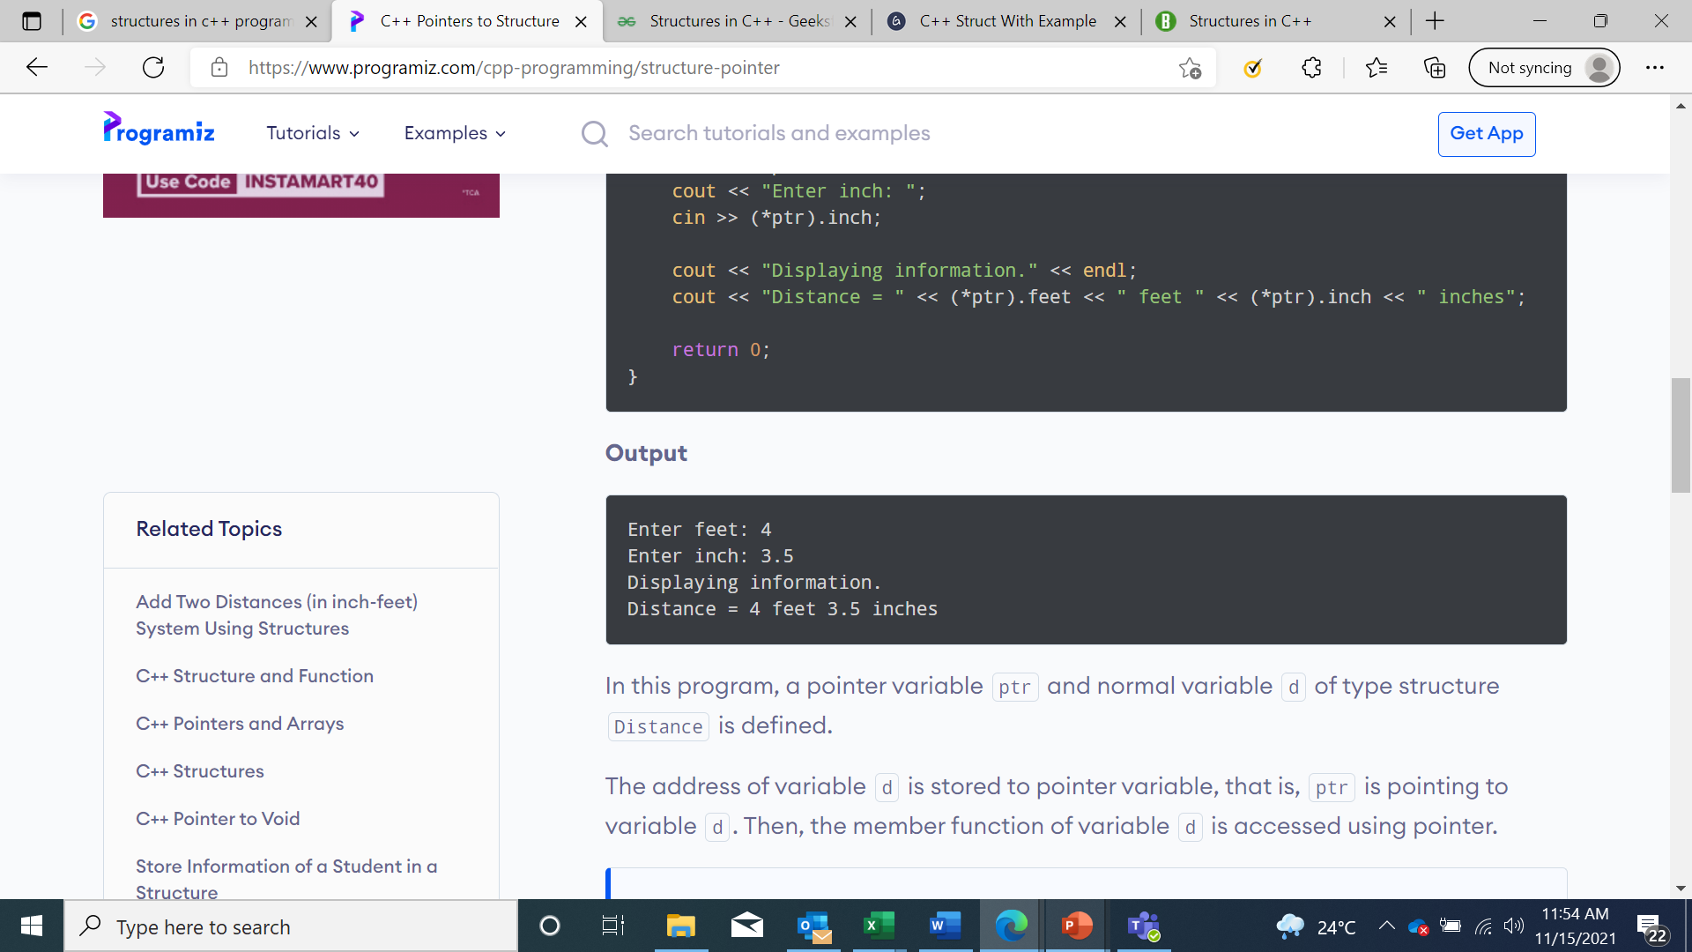
Output

Slide 13
Example 2- Pointers to structure
#include <iostream>
using namespace std;
struct Point {
int x, y;
};
int main()
{
struct Point p1 = { 1, 2 };
// p2 is a pointer to structure p1
struct Point* p2 = &p1;
// Accessing structure members using
// structure pointer
cout << p2->x << " " << p2->y;
return 0;
}
Output:
1 2

Slide 14
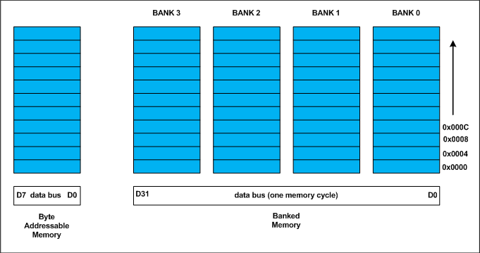
Aligned and un-aligned data storage
Every data type in C/C++ will have alignment requirement (infact it is mandated by processor architecture, not by language).
A processor will have processing word length as that of data bus size. On a 32 bit machine, the processing word size will be 4 bytes.

Slide 15




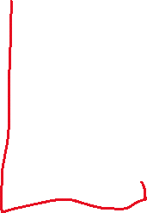





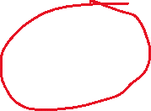












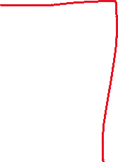


Slide 16




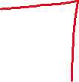





Slide 17
Aligned and un-aligned data storage
Memory is byte addressable and arranged sequentially. If the memory is arranged as single bank of one byte width, the processor needs to issue 4 memory read cycles to fetch an integer.
It is more economical to read all 4 bytes of integer in one memory cycle. To take such advantage, the memory will be arranged as group of 4 banks. The memory addressing still be sequential.
If bank 0 occupies an address X, bank 1, bank 2 and bank 3 will be at (X + 1), (X + 2) and (X + 3) addresses.
If an integer of 4 bytes is allocated on X address (X is multiple of 4), the processor needs only one memory cycle to read entire integer.

Slide 18
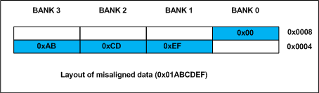




























Aligned and un-aligned data storage
Where as, if the integer is allocated at an address other than multiple of 4, it spans across two rows of the banks as shown in the below figure. Such an integer requires two memory read cycle to fetch the data.

Slide 19
Aligned and un-aligned data storage
A variable’s data alignment deals with the way the data stored in these banks.
For example, the natural alignment of int on 32-bit machine is 4 bytes. When a data type is naturally aligned, the CPU fetches it in minimum read cycles.
Similarly, the natural alignment of short int is 2 bytes. It means, a short int can be stored in bank 0 – bank 1 pair or bank 2 – bank 3 pair.
A double requires 8 bytes, and occupies two rows in the memory banks. Any misalignment of double will force more than two read cycles to fetch double data.N
Note that a double variable will be allocated on 8 byte boundary on 32 bit machine and requires two memory read cycles. On a 64 bit machine, based on number of banks, double variable will be allocated on 8 byte boundary and requires only one memory read cycle.

Slide 20
Structure Padding:
In C/C++ the structures are used as data pack. It doesn’t provide any data encapsulation or data hiding features (C++ case is an exception due to its semantic similarity with classes).
Because of the alignment requirements of various data types, every member of structure should be naturally aligned. The members of structure allocated sequentially increasing order.

Slide 21
Example - Aligned and un-aligned data storage
#include <stdio.h>
// Alignment requirements
// (typical 32 bit machine)
// char 1 byte
// short int 2 bytes
// int 4 bytes
// double 8 bytes
// structure A
typedef struct structa_tag
{
char c;
short int s;
} structa_t;
// structure B
typedef struct structb_tag
{
short int s;
char c;
int i;
} structb_t;

Slide 24
Example - Aligned and un-aligned data storage
// structure C
typedef struct structc_tag
{
char c; - 1 byte ,
double d;
int s;
} structc_t;
// structure D
typedef struct structd_tag
{
double d;
int s;
char c;
} structd_t;
int main()
{
printf("sizeof(structa_t) = %lu\n", sizeof(structa_t));
printf("sizeof(structb_t) = %lu\n", sizeof(structb_t));
printf("sizeof(structc_t) = %lu\n", sizeof(structc_t));
printf("sizeof(structd_t) = %lu\n", sizeof(structd_t));
return 0;
}

Slide 25
Discussion on Output of Program:
For the sake of convenience, assume every structure type variable is allocated on 4 byte boundary (say 0x0000), i.e. the base address of structure is multiple of 4 (need not necessary always, see explanation of structc_t).
structure A
The structa_t first element is char which is one byte aligned, followed by short int.
short int is 2 byte aligned.
If the short int element is immediately allocated after the char element, it will start at an odd address boundary.
The compiler will insert a padding byte after the char to ensure short int will have an address multiple of 2 (i.e. 2 byte aligned).
The total size of structa_t will be sizeof(char) + 1 (padding) + sizeof(short), 1 + 1 + 2 = 4 bytes.
Short int | Short int | padding | char

Slide 26
Discussion on Output of Program:
structure B The first member of structb_t is short int followed by char.
Since char can be on any byte boundary no padding required in between short int and char, on total they occupy 3 bytes.
The next member is int.
If the int is allocated immediately, it will start at an odd byte boundary.
We need 1 byte padding after the char member to make the address of next int member is 4 byte aligned.
On total, the structb_t requires 2 + 1 + 1 (padding) + 4 = 8 bytes.
int | int | int | int
 | char | Short int | Short int

Slide 27
Discussion on Output of Program:
structure C – Every structure will also have alignment requirements
Applying same analysis, structc_t needs
sizeof(char) + 7 byte padding + sizeof(double) + sizeof(int) = 1 + 7 + 8 + 4 = 20 bytes. However, the sizeof(structc_t) will be 24 bytes.
It is because, along with structure members, structure type variables will also have natural alignment.
int | int | int | Int 16
double | double | double | Double 12
double | double | double | Double 8
 |  |  | 4
 |  |  | Charc 0

Slide 28
Discussion on Output of Program:
we declared an array of structc_t as shown below
structc_t structc_array[3];
Assume, the base address of structc_array is 0x0000 for easy calculations.
If the structc_t occupies 20 (0x14) bytes as we calculated,
the second structc_t array element (indexed at 1) will be at 0x0000 + 0x0014 = 0x0014.
It is the start address of index 1 element of array. The double member of this structc_t will be allocated on 0x0014 + 0x1 + 0x7 = 0x001C (decimal 28) which is not multiple of 8 and conflicting with the alignment requirements of double. As we mentioned on the top, the alignment requirement of double is 8 bytes.

Slide 29
Discussion on Output of Program:
Inorder to avoid such misalignment, compiler will introduce alignment requirement to every structure. It will be as that of the largest member of the structure.
In our case alignment of structa_t is 2, structb_t is 4 and structc_t is 8.
If we need nested structures, the size of largest inner structure will be the alignment of immediate larger structure. In structc_t of the above program, there will be padding of 4 bytes after int member to make the structure size multiple of its alignment.
Thus the sizeof (structc_t) is 24 bytes. It guarantees correct alignment even in arrays.

Slide 30
Discussion on Output of Program:
structure D – How to Reduce Padding? By now, it may be clear that padding is unavoidable. There is a way to minimize padding.
The programmer should declare the structure members in their increasing/decreasing order of size. An example is structd_t given in our code, whose size is 16 bytes in lieu of 24 bytes of structc_t.

Slide 31
What is structure packing?
Some times it is mandatory to avoid padded bytes among the members of structure.
For example, reading contents of ELF file header or BMP or JPEG file header.
We need to define a structure similar to that of the header layout and map it.
However, care should be exercised in accessing such members. Typically reading byte by byte is an option to avoid misaligned exceptions. There will be hit on performance. Most of the compilers provide non standard extensions to switch off the default padding like pragmas or command line switches.

Slide 32
Packing members in a structure
You can reduce the amount of memory that your application requires by packing data into structures. This is especially important if you need to store and access large arrays of data in embedded systems.
If individual data members in a structure are not packed, the compiler can add padding within the structure for faster access to individual members, based on the natural alignment of each member. Arm Compiler provides a pragma and attribute to pack the members in a structure or union without any padding.

Slide 33
Packing members in a structure
#pragma pack (n)
For each member, if n bytes is less than the natural alignment of the member,
then set the alignment to n bytes, otherwise the alignment is the natural alignment of the member
__attribute__((packed))
This is equivalent to #pragma pack (1). However, the attribute can also be used on individual members in a structure or union.

Slide 34
Structure without packing attribute or pragma
struct stc
{
char one;
short two;
char three;
int four;
} c,d;
int main (void)
{
c.one=1;
return 0;
}

Slide 35
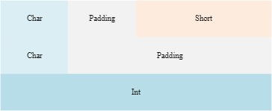
Size of structure in bytes
Size of structure =12.
The alignment of the structure is the natural alignment of the largest member. In this example, the largest member is an int

Slide 36
Structure with attribute packed
struct __attribute__((packed)) stc
{
char one;
short two;
char three;
int four;
} c,d;
int main (void)
{
c.one=1;
return 0;
}

Slide 37
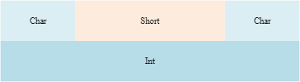
Size of structure in bytes
Size of structure = 8.
The alignment of the structure is 1 byte.

Slide 38
Structure with pragma pack with 1 byte alignment
#pragma pack (1) struct stc
{ char one;
short two;
char three;
int four;
} c,d;
int main (void)
{ c.one=1;
return 0;
}

Slide 39
Size of structure in bytes
Size of structure= 8.
The alignment of the structure is 1 byte.

Slide 40
Structure with pragma pack with 2 byte alignment
#pragma pack (2) struct stc
{ char one;
short two;
char three;
int four;
} c,d;
int main (void)
{ c.one=1;
return 0;
}

Slide 41
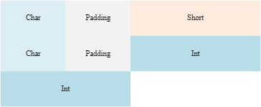
Size of structure in bytes
.
Size of structure= 10.
The alignment of the structure is 2 bytes.

Slide 42
Structure with pragma pack with 4 byte alignment
#pragma pack (4) struct stc
{
char one;
short two;
char three;
int four;
} c,d;
int main (void)
{
c.one=1;
return 0;
}

Slide 43
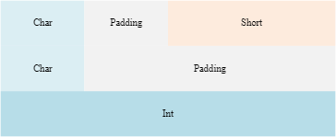
Size of structure in bytes
Size of structure= 12.
The alignment of the structure is 4 bytes.

Slide 44
Packing individual members in a structure
To pack individual members of a structure, use __attribute__((packed)) on the member.
This aligns the member to a byte boundary and therefore reduces the amount of memory required by the structure as a whole.
It does not affect the alignment of the other members.
Therefore the alignment of the whole structure is equal to the alignment of the largest member without the __attribute__((packed)).

Slide 45
Packing individual members
struct stc
{
char one;
short two;
char three;
int __attribute__((packed)) four;
} c,d;
int main (void)
{
c.one=1;
return 0;
}

Slide 46
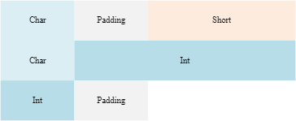
Size of structure in bytes
Size of structure =10.
The alignment of the structure is 2 bytes because the largest member without __attribute__((packed)) is short

Slide 47
Accessing packed members from a structure
If a member of a structure or union is packed and therefore does not have its natural alignment, then to access this member, you must use the structure or union that contains this member.
You must not take the address of such a packed member to use as a pointer, because the pointer might be unaligned.
Dereferencing such a pointer can be unsafe even when unaligned accesses are supported by the target, because certain instructions always require word-aligned addresses.

Slide 48
Accessing packed members from a structure
struct __attribute__((packed)) foobar
{
char x;
short y;
};
short get_y(struct foobar *s)
{
// Correct usage: the compiler will not use unaligned accesses
// unless they are allowed.
return s->y;
}
short get2_y(struct foobar *s)
{
short *p = &s->y; // Incorrect usage: 'p' might be an unaligned pointer.
return *p; // This might cause an unaligned access.
}

Slide 49
Type definitions and structures
typedef is used to assign a new name to structure which is a user-defined datatype as follows:
typedef struct structure_name { data-type member-1; data-type member-2; data-type member-3; data-type member-4; }type_name;
Now, while declaring variables of this structure type, we can write type_name in place of struct structure_name in the whole program.

Slide 50
Type definitions and structures - Example
#include <iostream>
#include <cstring>
using namespace std;
typedef struct student
{
int roll_no;
char name[30];
int phone_number;
}st;

Slide 51
Type definitions and structures - Example
int main(){
st p1, p2, p3;
p1.roll_no = 1;
strcpy(p1.name,"Brown");
p1.phone_number = 123443;
p2.roll_no = 2;
strcpy(p2.name,"Sam");
p2.phone_number = 1234567822;
p3.roll_no = 3;
strcpy(p3.name,"Addy");
p3.phone_number = 1234567844;
cout << "First Student" << endl;
cout << "roll no : " << p1.roll_no << endl;
cout << "name : " << p1.name << endl;
cout << "phone no : " << p1.phone_number << endl;
cout << "Second Student" << endl;
cout << "roll no : " << p2.roll_no << endl;
cout << "name : " << p2.name << endl;
cout << "phone no : " << p2.phone_number << endl;
cout << "Third Student" << endl;
cout << "roll no : " << p3.roll_no << endl;
cout << "name : " << p3.name << endl;
cout << "phone no : " << p3.phone_number << endl;
return 0;
}

Slide 52
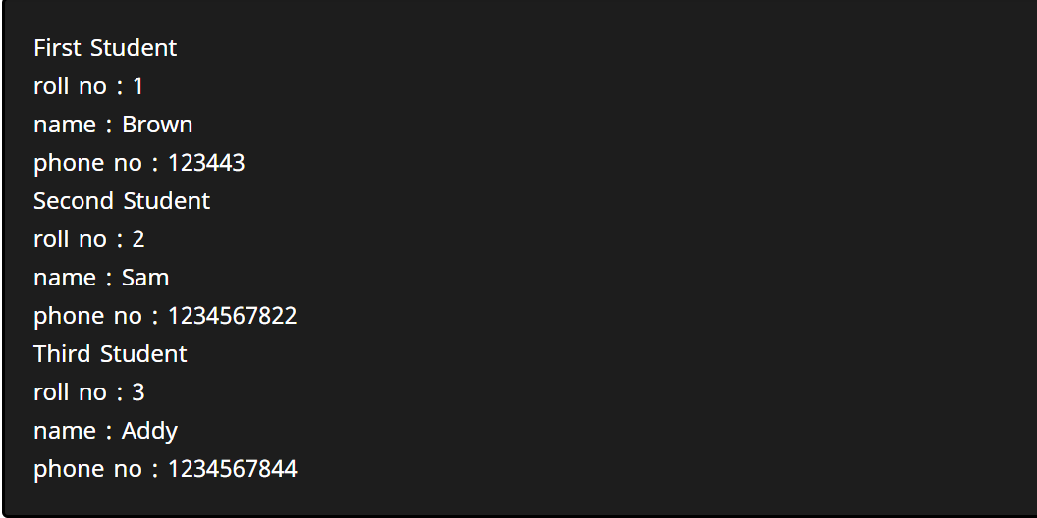
Type definitions and structures - Example

Slide 53
Structure and bit fields - Declaration and Usage
struct FileAttributes
{
unsigned int ReadOnly: 1;
unsigned int Hidden: 1;
};
Here, each of these two fields will occupy 1 bit in memory. It is specified by : 1 expression after the variable names. Base type of bit field could be any integral type (8-bit int to 64-bit int). Using unsigned type is recommended

Slide 55
Structure and bit fields - Declaration and Usage
If more bits are required, replace "1" with number of bits required. For example:
struct Date
{
unsigned int Year : 13; // 2^13 = 8192, enough for "year" representation for long time
unsigned int Month: 4; // 2^4 = 16, enough to represent 1-12 month values.
unsigned int Day: 5; // 32
};
The whole structure is using just 22 bits, and with normal compiler settings, sizeof this structure would be 4 bytes.

Slide 56
Structure and bit fields - Declaration and Usage
Usage is pretty simple. Just declare the variable, and use it like ordinary structure.
Date d;
d.Year = 2016;
d.Month = 7;
d.Day = 22;
std::cout << "Year:" << d.Year << std::endl <<
"Month:" << d.Month << std::endl <<
"Day:" << d.Day << std::endl;

Slide 57
Self referential structure
typedef struct {
char data;
Struct list *link;
} list;
List item1, item2,item3;
Item1.data =‘a’;
Item2.data =‘b’;
Item3.data= ‘c’;
Item1.link= item2.link=item3.link= NULL;
Item1.link=&item2; item2.link =&item3.link

Slide 58
1. Create a structure called time. Its three members, all type int, should be called hours, minutes and seconds. Write a program that prompt the user to enter a time value in hours, minutes and seconds. This can be in the format 12:59:59, then store the time in a varible of type struct time and finally print out the total number of seconds represented by time value.
2. write a program to obtain two time values from the user in 12:59:59 format store them in structure variable, convert each one to seconds, add these quantities, convert the result back to hours: minutes: seconds format and finally display in 12:59:59 format

Slide 59
References
Arm Compiler User Guide Version 6.16
Structure Member Alignment, Padding and Data Packing – GeeksforGeeks
C++ Structure and Function (programiz.com)

Slide 60
Thank You
Notes:
Thank You.

